Slide 1

50.039 Theory and Practice of Deep Learning W9-S3 Graph Convolutional Networks
Matthieu De Mari

Slide 2
About this week (Week 9)
What are graph objects?
How do we define a graph object mathematically?
What are typical graph problems?
How can we embed a graph object to later feed it to a Neural Network?
What is a graph convolution and how des it relate to the concept of image convolution?
What are more advanced problems and approaches on graph convolutional Neural Networks?

Slide 3
Outline
In this lecture (Continued from previous lecture)
Graph Convolutional Neural Networks
Feature engineering in Graph Convolutional Neural Networks
In this lecture, also
Graph Convolutional Neural Networks with Attention Mechanisms
Some more advanced graph embeddings

Slide 4
Graph convolutional layer (Kipf)
Definition (graph convolutional layer, with conventional spectral propagation rule):
$$H=σ\left(\hat{N}XW\right)=σ\left({\hat{D}}^{−1}ÂXW\right)$$
With $σ$ an activation function (so far we used identity), and $W$ a weight matrix, which we will train later on.
Definition (graph convolutional layer, with Kipf spectral propagation rule [Kipf]):
$$H=σ\left({\hat{N}}^{kipf}XW\right)$$
$$=σ\left({\hat{D}}^{−\frac{1}{2}}Â{\hat{D}}^{−\frac{1}{2}}XW\right)$$
Slightly better than ${\hat{D}}^{−1}Â$, especially in oriented graphs.
$M={\hat{D}}^{−\frac{1}{2}}Â{\hat{D}}^{−\frac{1}{2}}$ is called the symmetric Laplacian of the graph.
[Kipf] Kipf, T. N., & Welling, M. (2016). Semi-supervised classification with graph convolutional networks.

Slide 5
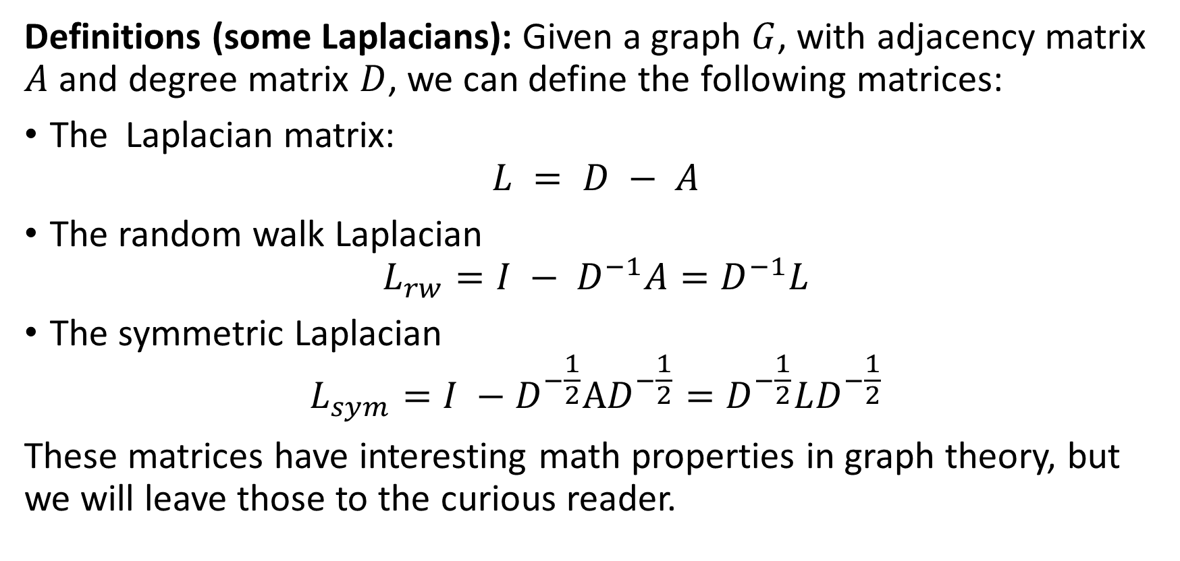
A quick word on Laplacians (out of class)
Definitions (some Laplacians): Given a graph $G$, with adjacency matrix $A$ and degree matrix $D$, we can define the following matrices:
The Laplacian matrix: $L = D − A$
The random walk Laplacian
$$L_{rw}=I − D^{−1}A=D^{−1}L$$
The symmetric Laplacian
$$L_{sym}={I −D}^{−\frac{1}{2}}AD^{−\frac{1}{2}}=D^{−\frac{1}{2}}LD^{−\frac{1}{2}}$$
These matrices have interesting math properties in graph theory, but we will leave those to the curious reader.

Slide 6
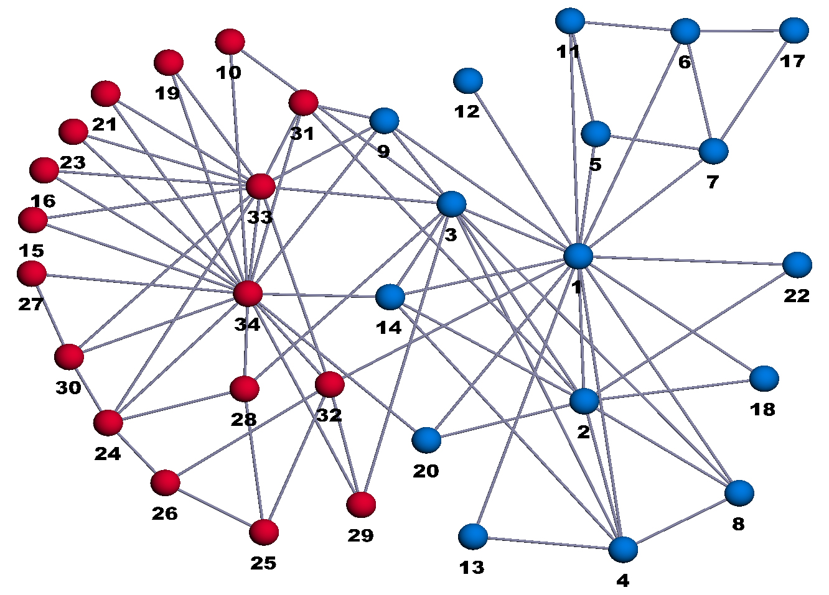
A more sophisticated toy example
Zachary Karate Fight club [ZKC]:
34 members, as nodes, indexed from 1 to 34.
Mr. Hi, the owner is node 1.
The Officer/Trainer is node 34.
All other nodes are members.
Edges define friendships between individuals.
Question: If Mr. Hi and the officer/trainer decide to fight, what will be the teams?
[ZKC] Zachary, W. W. (1977). An information flow model for conflict and fission in small groups.

Slide 7
A more sophisticated toy example
Zachary Karate Fight club [ZKC]:
It consists of a binary classification problem.
Separate the nodes (as with any classification problem)
[ZKC] Zachary, W. W. (1977). An information flow model for conflict and fission in small groups.

Slide 8
Building blocks for classifier
Graph data
$$(A, D, Â, \hat{D}, \hat{N}, X)$$
Graph data
(𝐴, 𝐷, Â, 𝐷 ̂, 𝑁 ̂, 𝑋)
Graph convolutional layer #1
$$H_{1}=σ({\hat{N}}^{kipf}XW_{1})$$
Graph convolutional layer #1
𝐻_1=𝜎(𝑁 ̂^𝑘𝑖𝑝𝑓 𝑋𝑊_1)
Embedding $H_{2}$ for graph data
Embedding 𝐻_2 for graph data
Graph convolutional layer #2
$$H_{2}=σ({\hat{N}}^{kipf}H_{1}W_{2})$$
Graph convolutional layer #2
𝐻_2=𝜎(𝑁 ̂^𝑘𝑖𝑝𝑓 𝐻_1 𝑊_2)
Logistic Regression
Classification task on graph dataset (ZKC).
Structure:
2 GCN layers (with Kipf propagation rule)
1 Logistic Regression for classification
emb_model
model

Slide 9
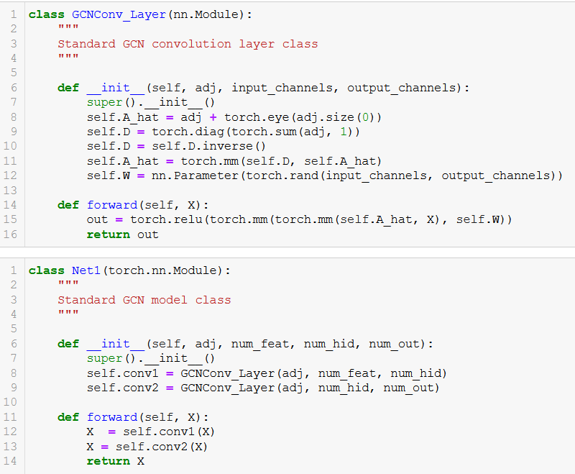
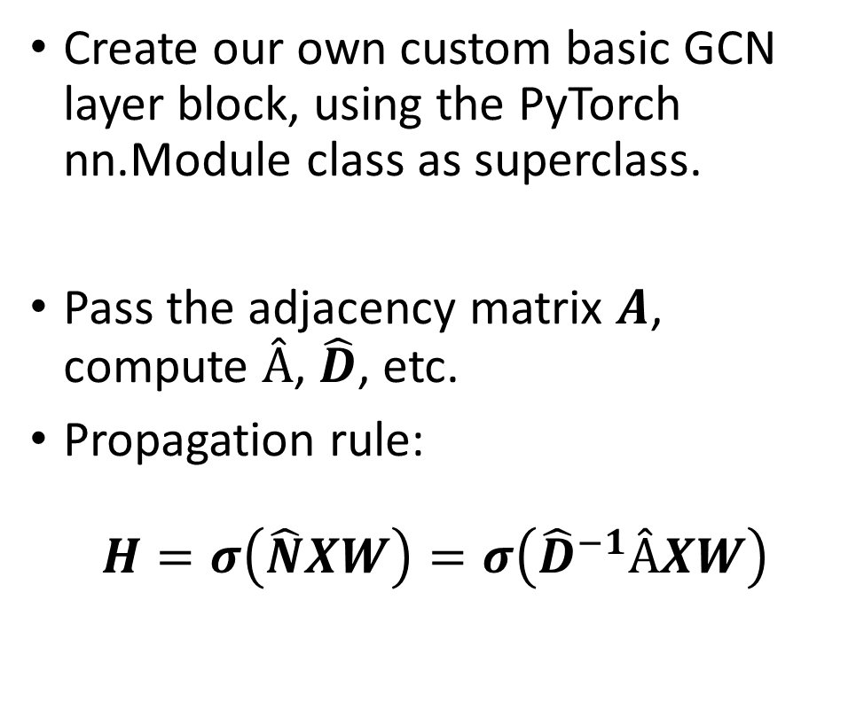
Building a basic GCN layer and model
Create our own custom basic GCN layer block, using the PyTorch nn.Module class as superclass.
Pass the adjacency matrix $A$, compute $Â$, $\hat{D}$, etc.
Propagation rule:
$$H=σ\left(\hat{N}XW\right)=σ\left({\hat{D}}^{−1}ÂXW\right)$$

Slide 10
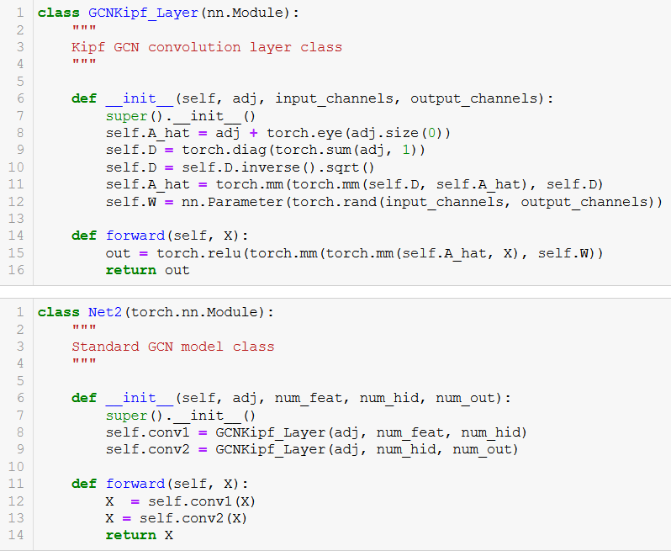
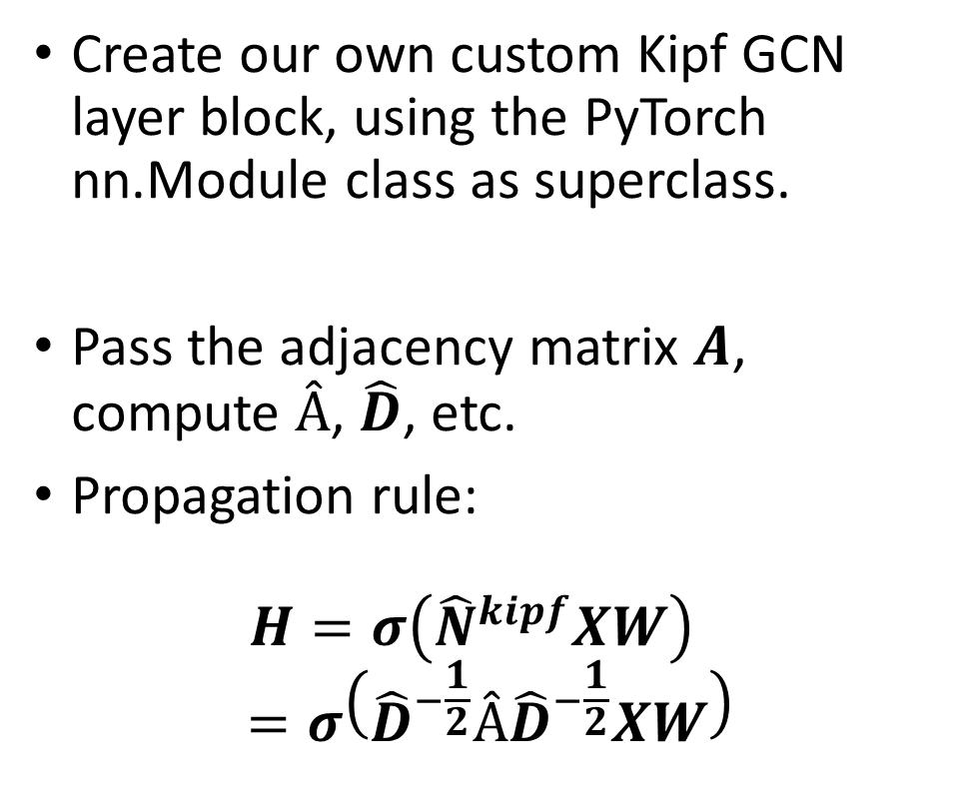
Building a Kipf GCN layer and model
Create our own custom Kipf GCN layer block, using the PyTorch nn.Module class as superclass.
Pass the adjacency matrix $A$, compute $Â$, $\hat{D}$, etc.
Propagation rule: $H=σ\left({\hat{N}}^{kipf}XW\right)$
$$=σ\left({\hat{D}}^{−\frac{1}{2}}Â{\hat{D}}^{−\frac{1}{2}}XW\right)$$

Slide 11
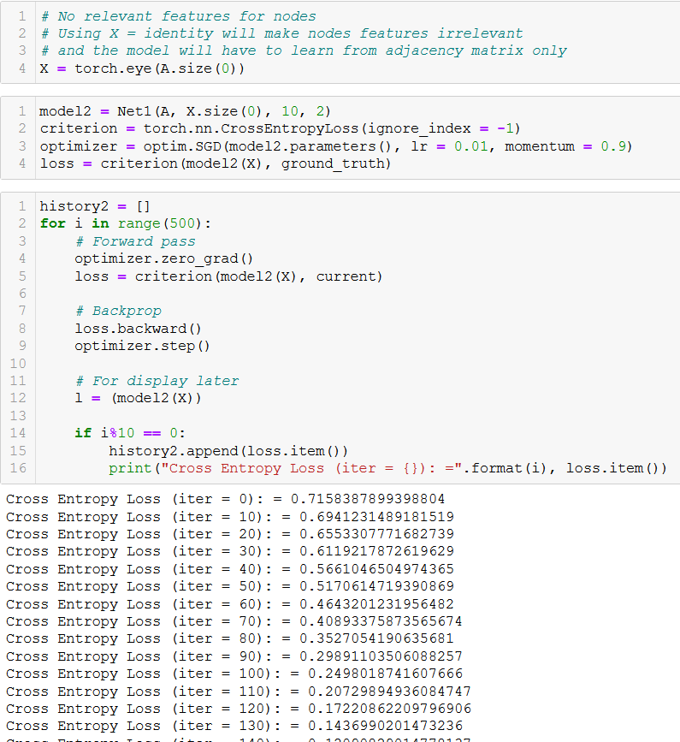
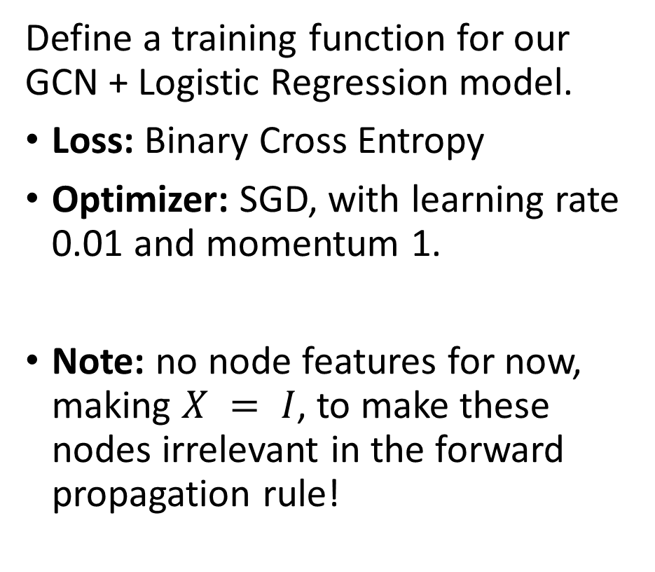
Trainer definition
Define a training function for our GCN + Logistic Regression model.
Loss: Binary Cross Entropy
Optimizer: SGD, with learning rate 0.01 and momentum 1.
Note: no node features for now, making $X = I$, to make these nodes irrelevant in the forward propagation rule!

Slide 12
Train model (no features)
Overall, the model is learning but it takes time to do so properly.
The model attempts to learn from the adjacency matrix and degree matrix only…
It however has no useful nodes features it could rely on.
Kipf formula seems to make the training slightly faster.

Slide 13

Train model (no features)
Overall, the model is learning but it takes time to do so properly.
The model attempts to learn from the adjacency matrix and degree matrix only…
It however has no useful nodes features it could rely on.
Kipf formula seems to make the training slightly faster.

Slide 14
Build model: adding nodes features
The nodes have no features.
→ Needs feature engineering
Some interesting features for the nodes would be
the hop-distance to Mr. Hi (i.e. node 0),
and the hop-distance to the officer/trainer (i.e. node 33).
Use a simple BFS to calculate them!

Slide 15
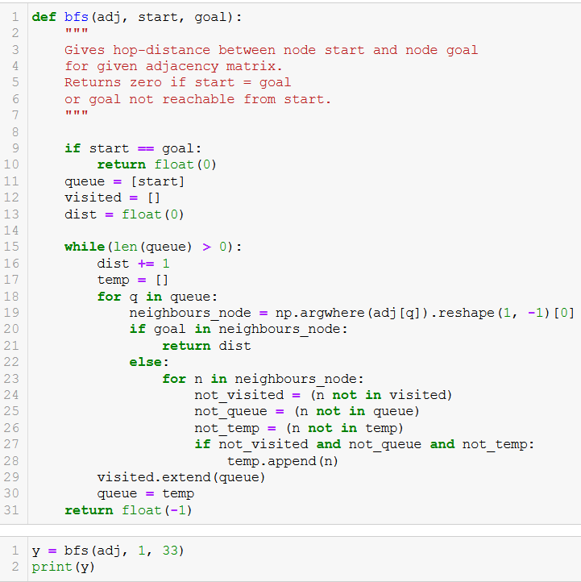
Build model: adding nodes features
The nodes have no features.
→ Needs feature engineering
Some interesting features for the nodes would be
the hop-distance to Mr. Hi (i.e. node 0),
and the hop-distance to the officer/trainer (i.e. node 33).
Use a simple BFS to calculate them!

Slide 16
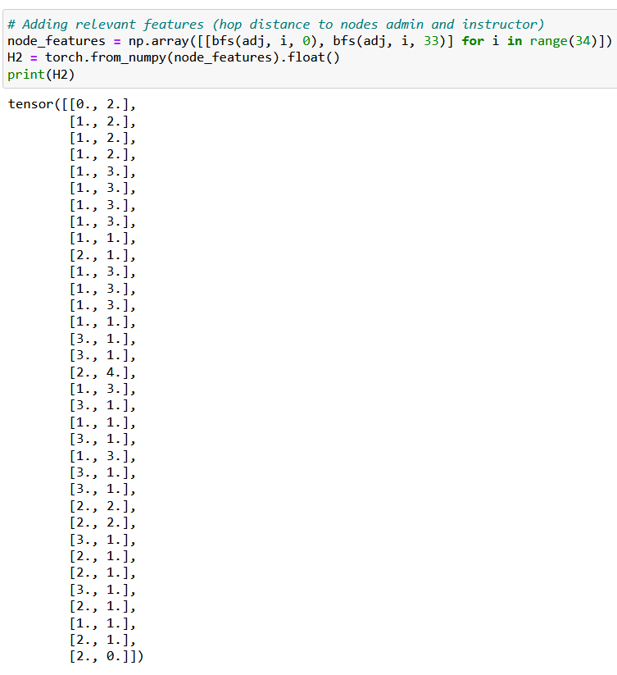
Build model: adding nodes features
The nodes have no features.
→ Needs feature engineering
Some interesting features for the nodes would be
the hop-distance to Mr. Hi (i.e. node 0),
and the hop-distance to the officer/trainer (i.e. node 33).
Use a simple BFS to calculate them!

Slide 17
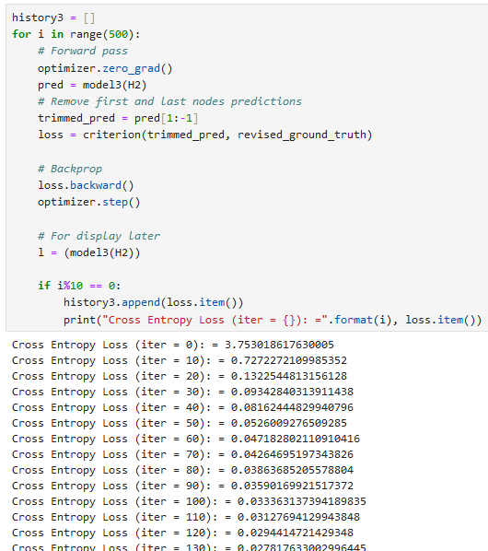
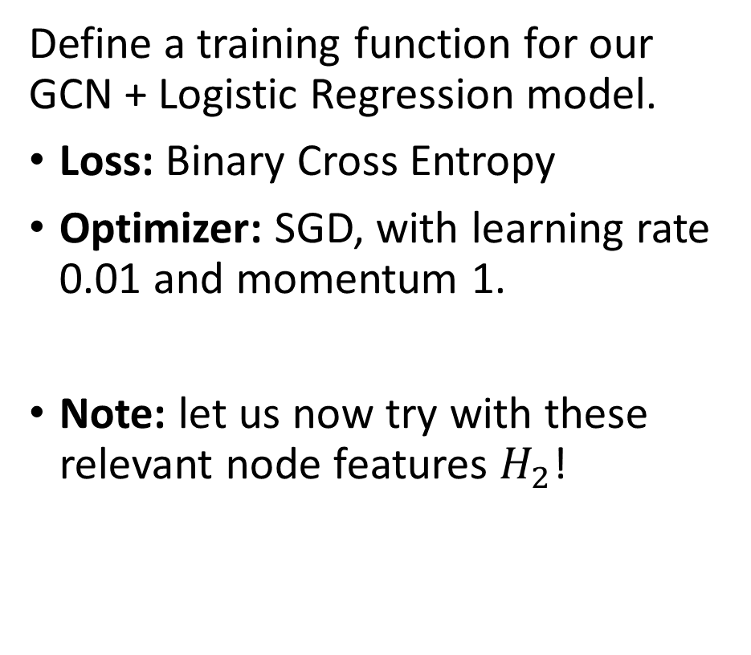
Trainer definition
Define a training function for our GCN + Logistic Regression model.
Loss: Binary Cross Entropy
Optimizer: SGD, with learning rate 0.01 and momentum 1.
Note: let us now try with these relevant node features $H_{2}$!

Slide 18
Train model (with some features)
Overall, the model is now able to train properly.
The model attempts to learn from the adjacency matrix and degree matrix only.
The hop-distances carry an information on the proximity of members to Mr. Hi and the Officer/Trainer.

Slide 19
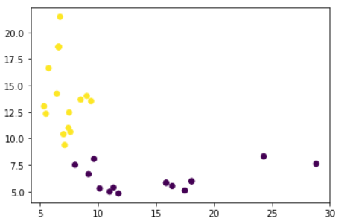
Train model (with some features)
Overall, the model is now able to train properly.
The model attempts to learn from the adjacency matrix and degree matrix only.
The hop-distances carry an information on the proximity of members to Mr. Hi and the Officer/Trainer.

Slide 20
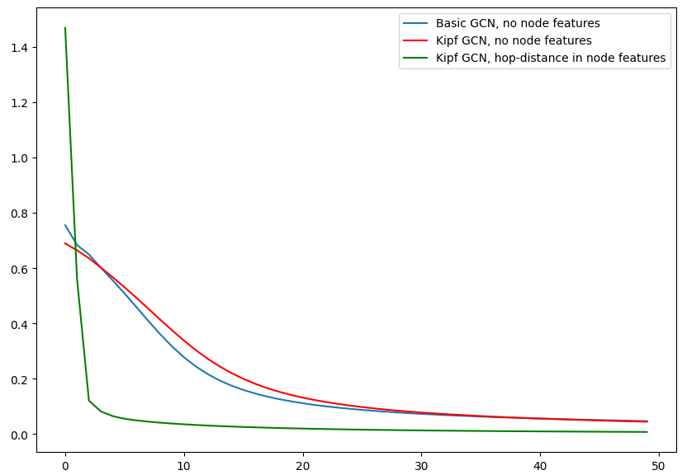
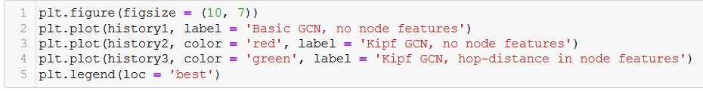
Train model (with some features)
Important message: Additional nodes features make the training much more efficient! Features engineering is key with graphs!

Slide 21
Additional features?
We could think of additional features to help the Graph Convolutional Neural Network learn. For instance:
Additional node features: for instance, number of close friends to Mr. Hi and Officer/Trainer among the neighbors of the node (close friends = nodes with hop-distance of 1).
Edge features: for instance, add a random “Friendship” value to the edges, that quantifies friendship between two nodes. Open question: Later on, how would you modify your propagation formulas to take into account the edge weights?
Challenge: Leaving the implementation of these extra features as challenge for you to practice!

Slide 22
Limits of the previous approaches
Let us discuss some of the key issues we have observed so far, and some issues we can intuitively guess will be problematic in these vanilla GCNs.

Slide 23
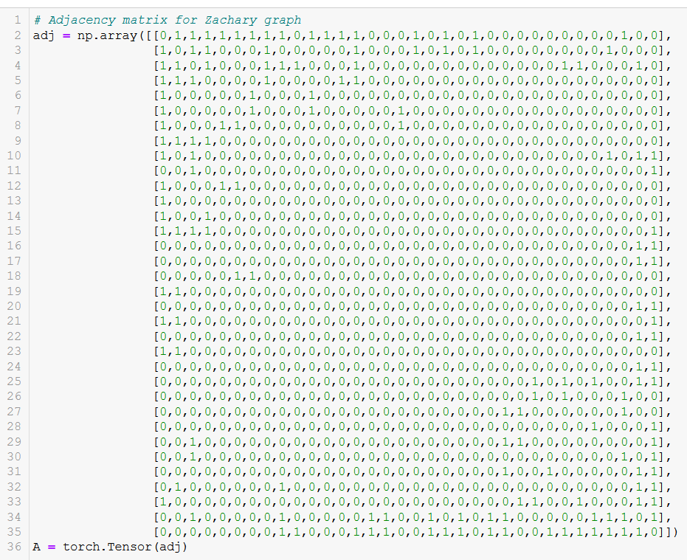
Limits of the previous approaches
Issue #1: Sparse graphs and computational cost of spectral embeddings:
These approaches rely on adjacency and degree matrix for a given graph.
On large graphs, it is heavy, computationally speaking.
Inefficient also, as most elements in the adjacency matrix are zeros.

Slide 24
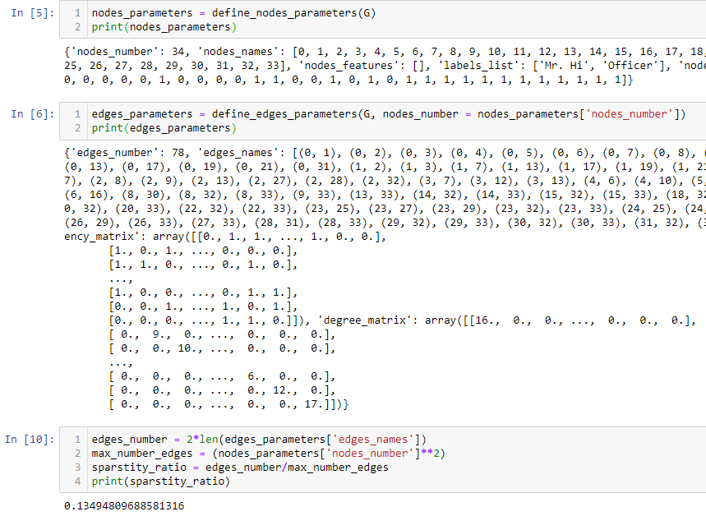
Limits of the previous approaches
Issue #1: Sparse graphs and computational cost of spectral embeddings:
These approaches rely on adjacency and degree matrix for a given graph.
On large graphs, it is heavy, computationally speaking.
Inefficient also, as most elements in the adjacency matrix are zeros.

Slide 25
Limits of the previous approaches
Issue #1: Sparse graphs and computational cost of spectral embeddings:
These approaches rely on adjacency and degree matrix for a given graph.
On large graphs, it is heavy, computationally speaking.
Inefficient also, as most elements in the adjacency matrix are zeros.
→ Need for scalable embeddings, operating locally for each node, instead of the “general” graph matrices.

Slide 26
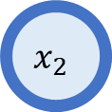
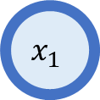
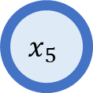
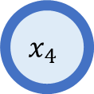
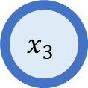
Limits of the previous approaches
$$x_{2}$$
$$x_{1}$$
Issue #2: Spectral embeddings work on fixed graphs structures
Our spectral embeddings work for a single given graph.
$$x_{4}$$
$$x_{3}$$
$$x_{5}$$

Slide 27
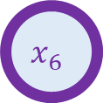
Limits of the previous approaches
$$x_{2}$$
$$x_{1}$$
Issue #2: Spectral embeddings work on fixed graphs structures
Our spectral embeddings work for a single given graph.
Adding a new node in the graph requires to reshape the whole embedding architecture.
$$x_{4}$$
$$x_{3}$$
$$x_{6}$$
$$x_{5}$$

Slide 28
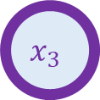
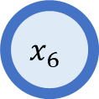
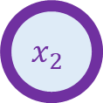
Limits of the previous approaches
$$x_{3}$$
$$x_{1}$$
Issue #2: Spectral embeddings work on fixed graphs structures
Our spectral embeddings work for a single given graph.
Adding a new node in the graph requires to reshape the whole embedding architecture.
Also fails if nodes names are swapped, even though it does not really change the graph structure, so to speak…
$$x_{4}$$
$$x_{2}$$
$$x_{6}$$
$$x_{5}$$
→ Need for scalable embeddings, operating locally for each node, instead of the “general” graph matrices.

Slide 29
Limits of the previous approaches
$$x_{2}$$
$$x_{1}$$
Issue #2: Spectral embeddings work on fixed graphs structures
Our spectral embeddings work for a single given graph.
Adding a new node in the graph requires to reshape the whole embedding architecture.
Also fails if nodes names are swapped, even though it does not really change the graph structure, so to speak…
$$x_{4}$$
$$x_{3}$$
$$x_{6}$$
$$x_{5}$$
→ Need for scalable embeddings, operating locally for each node, instead of the “general” graph matrices.

Slide 30
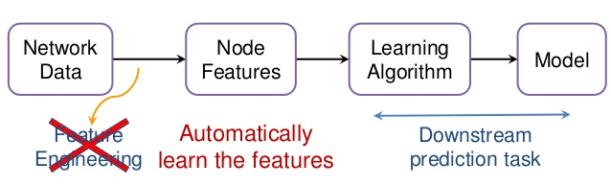
Limits of the previous approaches
Issue #3: Critical importance of nodes/edges features
We have seen the importance of nodes features for proper classification.
→ Need an automated process for learning the optimal features elements in a graph.

Slide 31
Limits of the previous approaches
Issue #4: Helping the graph identify more important nodes to propagate
Attention: selectively concentrating on a few relevant things, while ignoring others in deep neural networks.

Slide 32
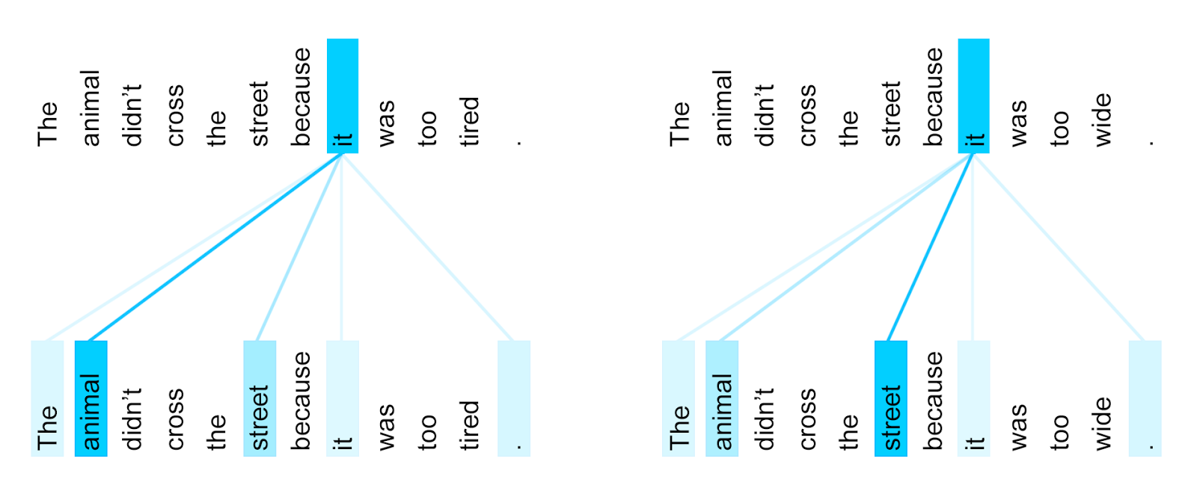
Limits of the previous approaches
Issue #4: Helping the graph identify more important nodes to propagate
Attention: selectively concentrating on a few relevant things, while ignoring others in deep neural networks.
Attention in NLP: identify words that are most relevant for a given word and propagate meaning to update word embedding.

Slide 33
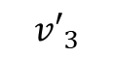
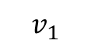
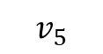
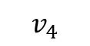
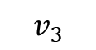
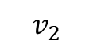

Limits of the previous approaches
Issue #4: Helping the graph identify more important nodes to propagate
Attention: selectively concentrating on a few relevant things, while ignoring others in deep neural networks.
Attention in NLP: identify words that are most relevant for a given word and propagate meaning to update word embedding.
$$v_{1}$$
$$v_{2}$$
$$v_{3}$$
$$v_{4}$$
$$v_{5}$$
Who’s eating?
What is being eaten?
Original Representation of word “eats”
Combine everything together
$$v_{3}^{′} ←f\left(v_{1}, v_{2}, …, v_{5}\right)$$
$${v′}_{3}$$

Slide 34
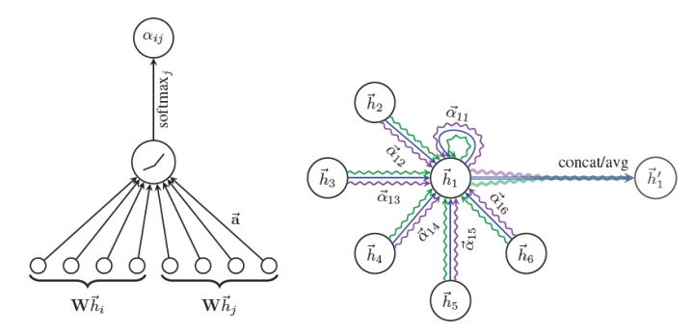
Limits of the previous approaches
Issue #4: Helping the graph identify more important nodes to propagate
Attention: selectively concentrating on a few relevant things, while ignoring others in deep neural networks.
→ Question: can we steal the attention concept from NLP and apply it in graphs to identify relevant neighboring nodes features for each node?

Slide 35
In this lecture
Graph Convolutional Networks: on-going research, with many questions yet to be solved.
Out of this lecture:
Implementing CNN-inspired layers, e.g. Max/Mean Pooling, on graphs. NLP-inspired concepts can also be used.
Graph-based Generative Adversarial Networks (reusing GANs concepts from next week)
Etc.
Local/advanced embeddings:
DeepWalk
Node2Vec
Inductive Representation Learning (GraphSAGE)
Graph Attention Networks
Going deeper: Good white paper, summarizing all concepts of GCN [Xu]
[Xu] Xu, K., Hu, W., Leskovec, J., & Jegelka, S. (2018). How powerful are graph neural networks?.

Slide 36
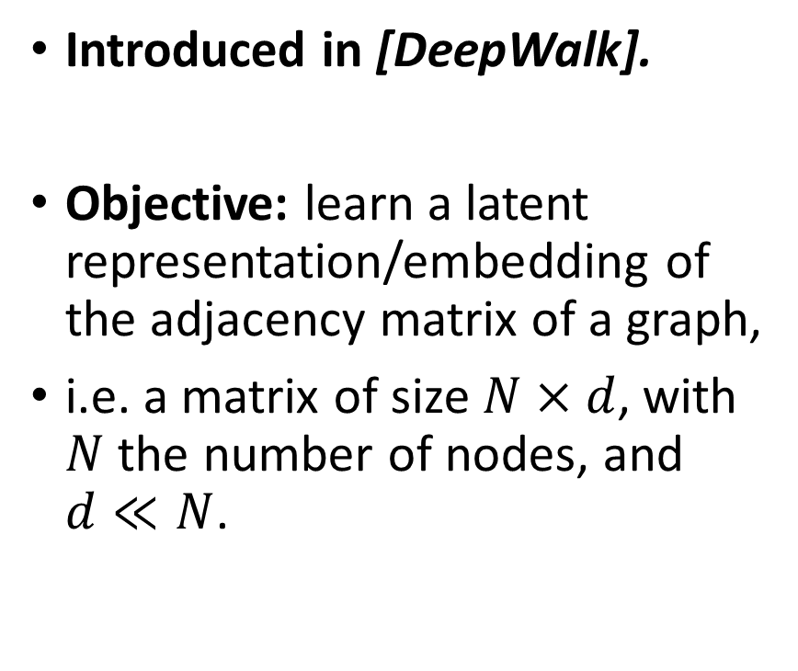
Local embeddings: DeepWalk
Introduced in [DeepWalk].
Objective: learn a latent representation/embedding of the adjacency matrix of a graph,
i.e. a matrix of size $N×d$, with $N$ the number of nodes, and $d≪N$.
[DeepWalk] Perozzi, B., Al-Rfou, R., & Skiena, S. (2014, August). Deepwalk: Online learning of social representations.

Slide 37
Local embeddings: DeepWalk
Introduced in [DeepWalk].
Objective: learn a latent representation/embedding of the adjacency matrix of a graph,
i.e. a matrix of size $N×d$, with $N$ the number of nodes, and $d≪N$.
Core idea: start from a node, and walk randomly in the graph (transition randomly from on node to another using edges)
Analogy NLP/Graph: Short sentences (NLP) = short random walks (Graphs)
[DeepWalk] Perozzi, B., Al-Rfou, R., & Skiena, S. (2014, August). Deepwalk: Online learning of social representations.

Slide 38
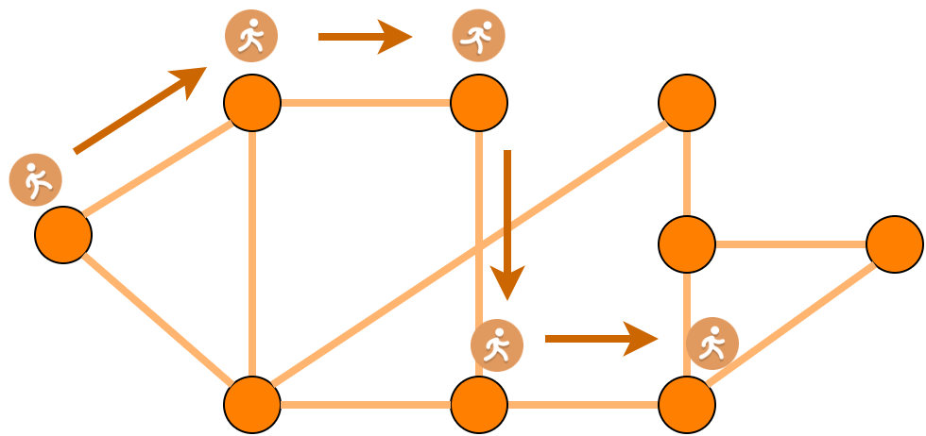
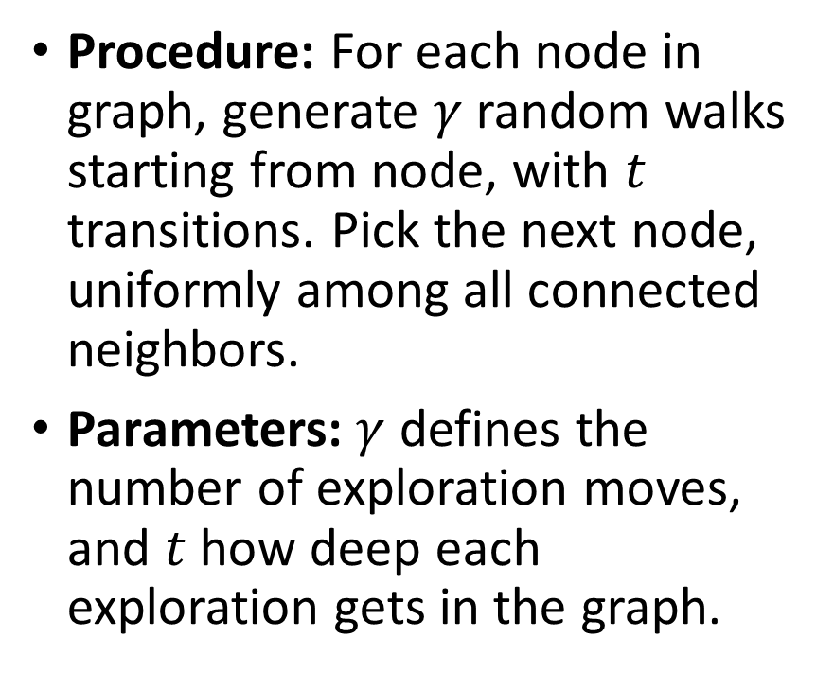
Local embeddings: DeepWalk
Procedure: For each node in graph, generate $γ$ random walks starting from node, with $t$ transitions. Pick the next node, uniformly among all connected neighbors.
Parameters: $γ$ defines the number of exploration moves, and $t$ how deep each exploration gets in the graph.
Note: No need to know the adjacency matrix. Each node only need to know its list of immediate neighbours.

Slide 39
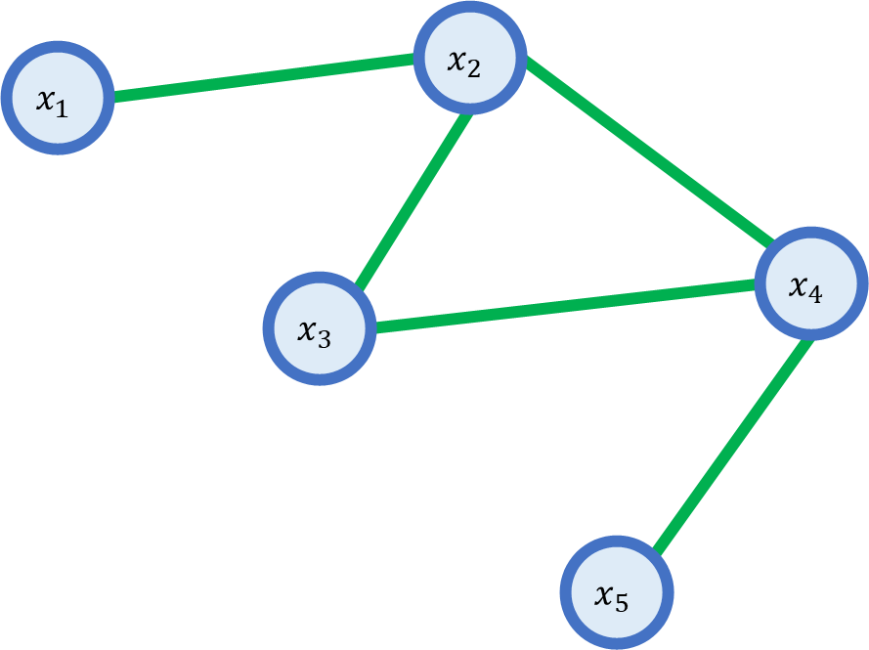
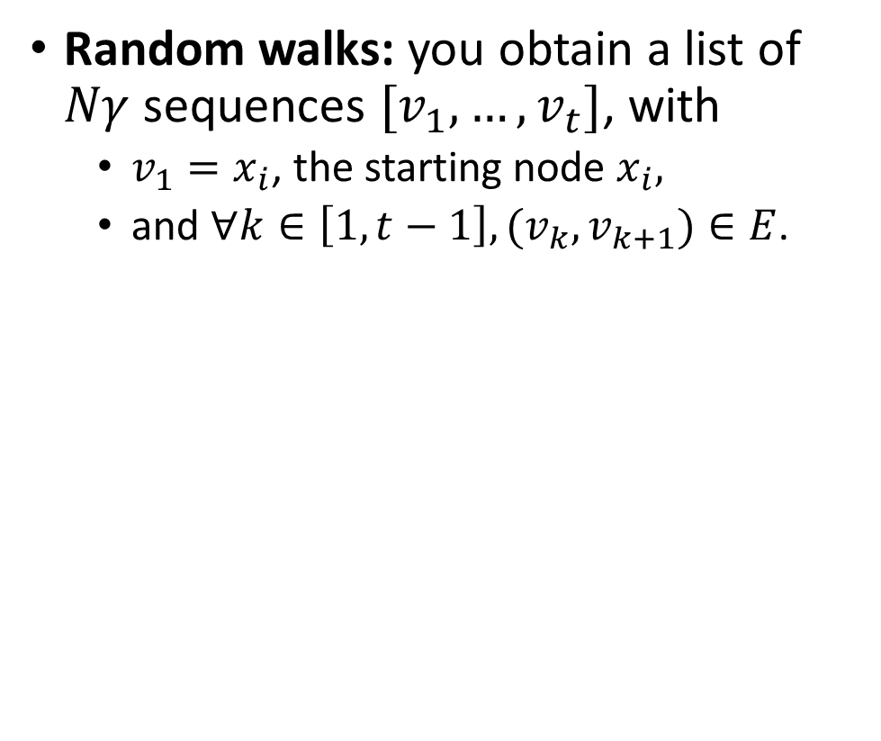
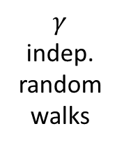
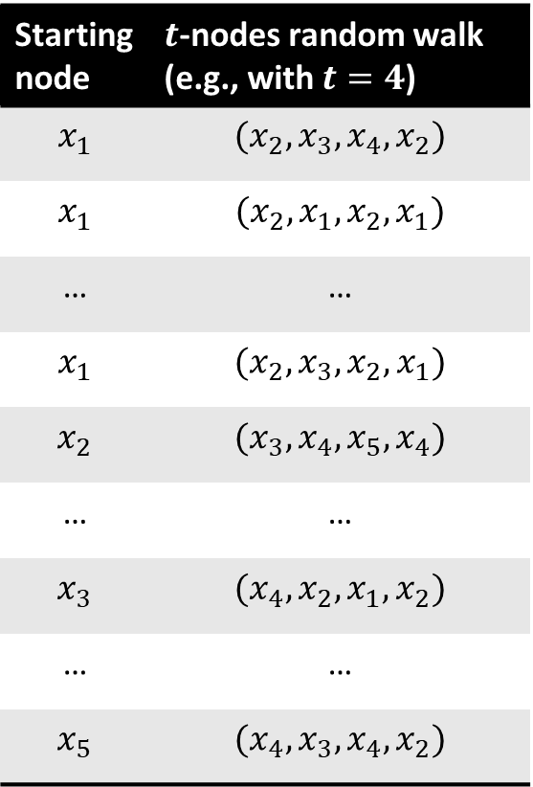
Local embeddings: DeepWalk
Random walks: you obtain a list of $Nγ$ sequences $[v_{1},…,v_{t}]$, with
$v_{1}=x_{i}$, the starting node $x_{i},$
and $∀k∈\left[1, t−1\right], {(v_{k}, v}_{k+1})∈E$.
Starting node | $t$-nodes random walk (e.g., with $t=4$)
$$x_{1}$$ | $$(x_{2},x_{3},x_{4},x_{2})$$
$$x_{1}$$ | $$(x_{2},x_{1},x_{2},x_{1})$$
… | …
$$x_{1}$$ | $$(x_{2},x_{3},x_{2},x_{1})$$
$$x_{2}$$ | $$(x_{3},x_{4},x_{5},x_{4})$$
… | …
$$x_{3}$$ | $$(x_{4},x_{2},x_{1},x_{2})$$
… | …
$$x_{5}$$ | $$(x_{4},x_{3},x_{4},x_{2})$$
$$γ$$
indep. random walks

Slide 40
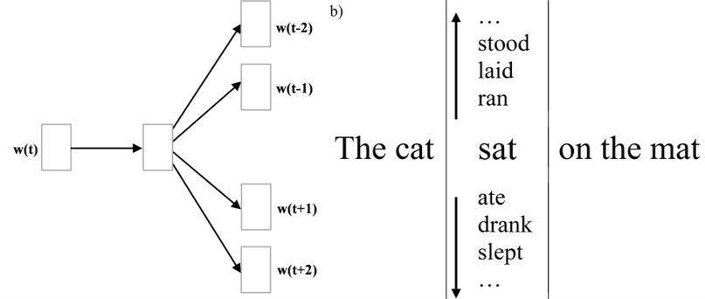
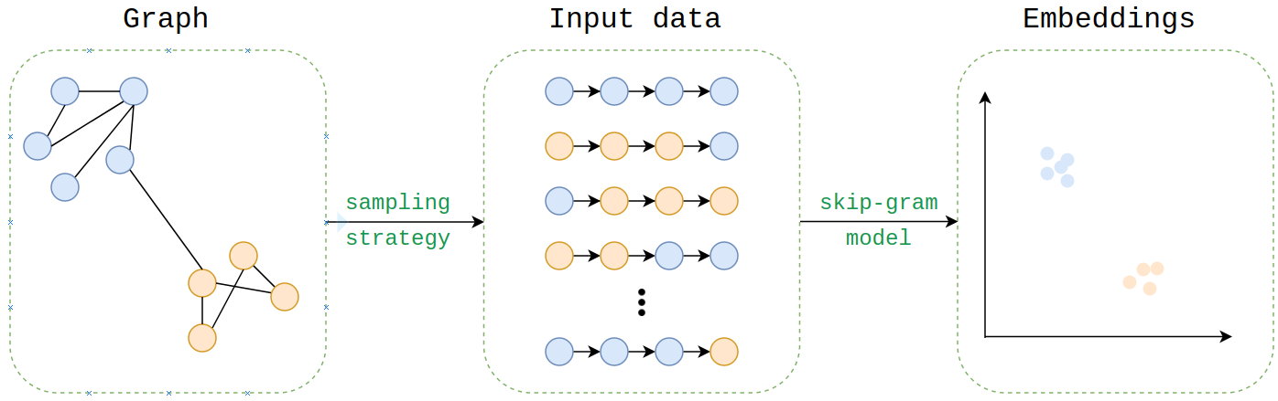
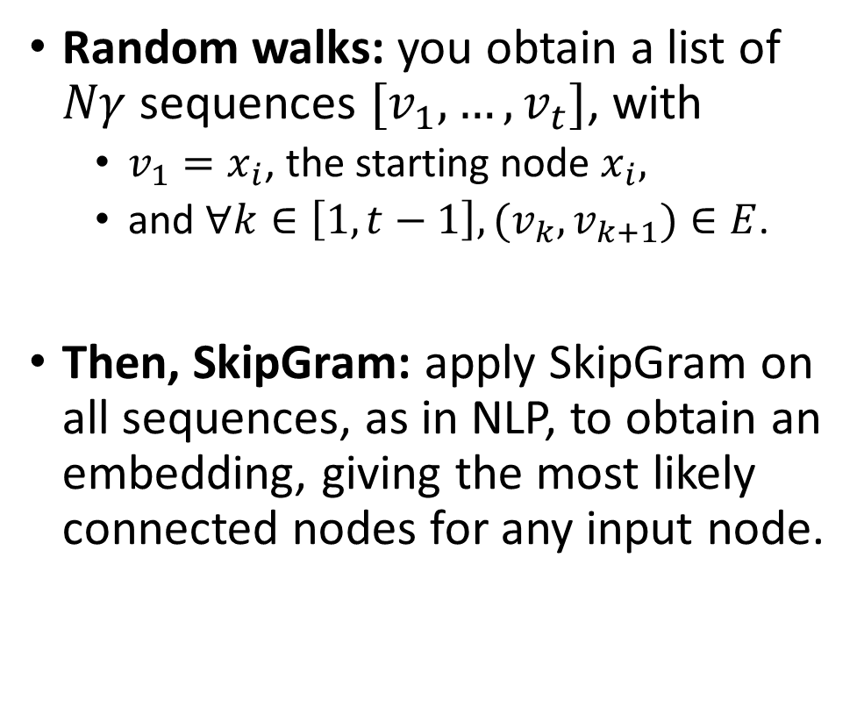
Local embeddings: DeepWalk
Random walks: you obtain a list of $Nγ$ sequences $[v_{1},…,v_{t}]$, with
$v_{1}=x_{i}$, the starting node $x_{i},$
and $∀k∈\left[1, t−1\right], {(v_{k}, v}_{k+1})∈E$.
Then, SkipGram: apply SkipGram on all sequences, as in NLP, to obtain an embedding, giving the most likely connected nodes for any input node.

Slide 41
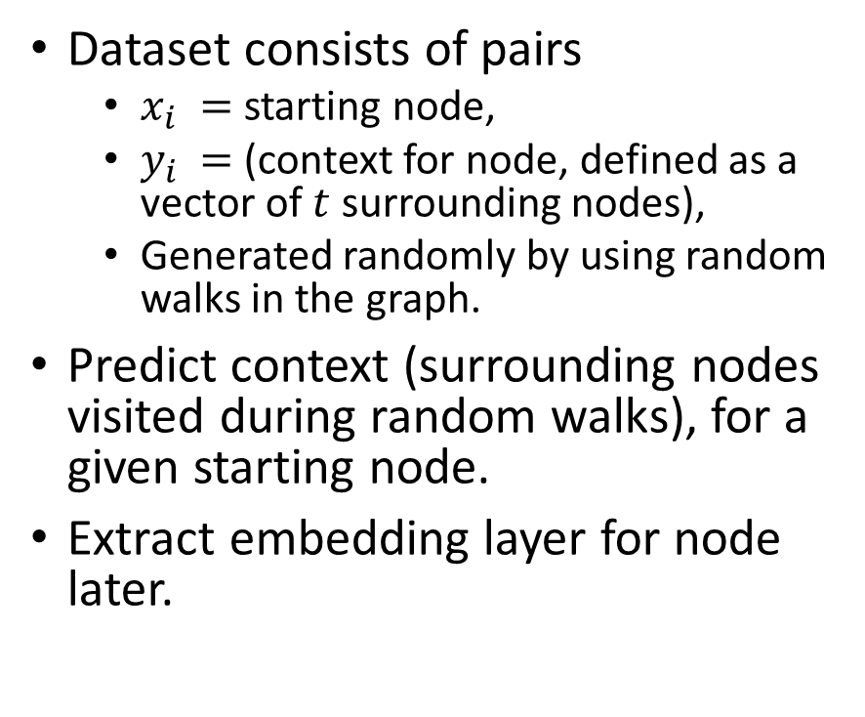
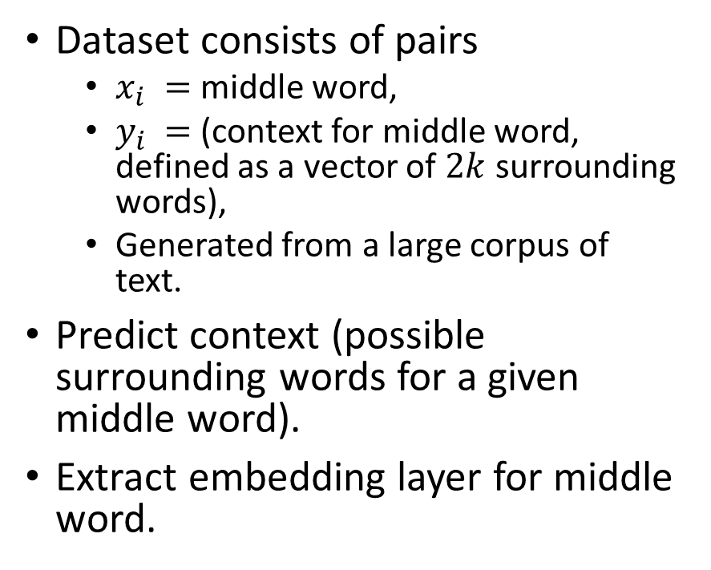
Analogy NLP/Graph for SkipGram
NLP (SkipGram)
Graph (DeepWalk)
Dataset consists of pairs
$x_{i} =$middle word,
$y_{i} =$(context for middle word, defined as a vector of $2k$ surrounding words),
Generated from a large corpus of text.
Predict context (possible surrounding words for a given middle word).
Extract embedding layer for middle word.
Dataset consists of pairs
$x_{i} =$ starting node,
$y_{i} =$(context for node, defined as a vector of $t$ surrounding nodes),
Generated randomly by using random walks in the graph.
Predict context (surrounding nodes visited during random walks), for a given starting node.
Extract embedding layer for node later.

Slide 42
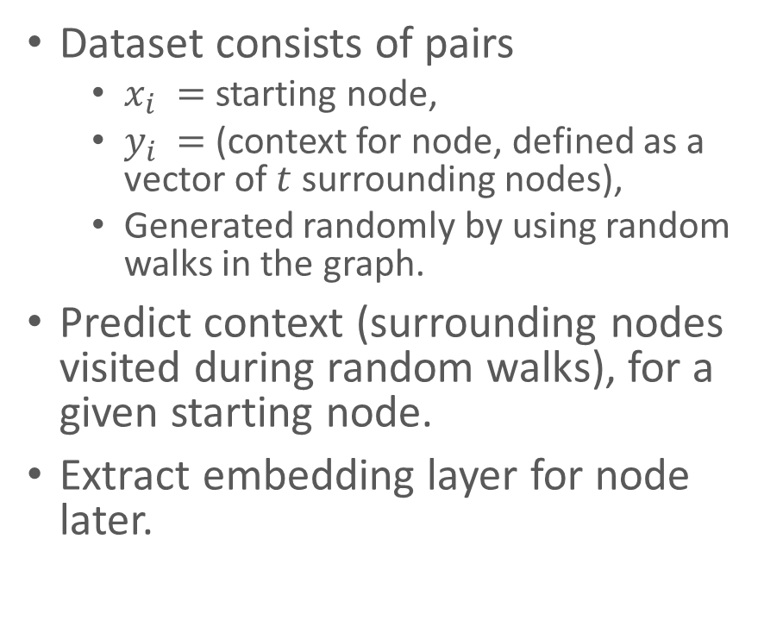
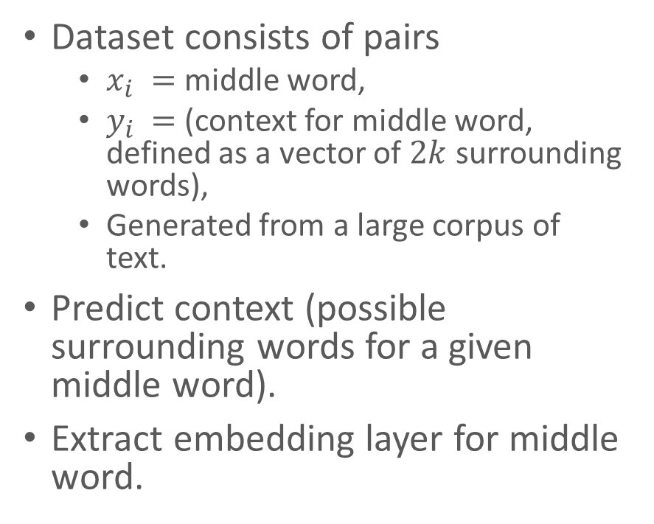
Analogy NLP/Graph for SkipGram
NLP (SkipGram)
Graph (DeepWalk)
Dataset consists of pairs
$x_{i} =$middle word,
$y_{i} =$(context for middle word, defined as a vector of $2k$ surrounding words),
Generated from a large corpus of text.
Predict context (possible surrounding words for a given middle word).
Extract embedding layer for middle word.
Dataset consists of pairs
$x_{i} =$ starting node,
$y_{i} =$(context for node, defined as a vector of $t$ surrounding nodes),
Generated randomly by using random walks in the graph.
Predict context (surrounding nodes visited during random walks), for a given starting node.
Extract embedding layer for node later.
Definition (the distributional hypothesis of linguistics):
We may rely on a fundamental linguistic assumption → Words often appearing in similar contexts/sentences tend to be related to each other.

Slide 43
Analogy NLP/Graph for SkipGram
NLP (SkipGram)
Graph (DeepWalk)
Dataset consists of pairs
$x_{i} =$middle word,
$y_{i} =$(context for middle word, defined as a vector of $2k$ surrounding words),
Generated from a large corpus of text.
Predict context (possible surrounding words for a given middle word).
Extract embedding layer for middle word.
Dataset consists of pairs
$x_{i} =$ starting node,
$y_{i} =$(context for node, defined as a vector of $t$ surrounding nodes),
Generated randomly by using random walks in the graph.
Predict context (surrounding nodes visited during random walks), for a given starting node.
Extract embedding layer for node later.
Equivalent (the distributional hypothesis of graphs?!):
Is there an equivalent fundamental graph assumption we could use? → Nodes often appearing in similar random walks tend to be related to each other?
+ Observation (Homophily property of graphs): Connected nodes in a graph tend to have similar features and labels.
Definition (the distributional hypothesis of linguistics):
We may rely on a fundamental linguistic assumption → Words often appearing in similar contexts/sentences tend to be related to each other.

Slide 44
Local embeddings: DeepWalk
Random walks: you obtain a list of $Nγ$ sequences $[v_{1},…,v_{t}]$, with
$v_{1}=x_{i}$, the starting node $x_{i},$
and $∀k∈\left[1, t−1\right], {(v_{k}, v}_{k+1})∈E$.
Then, SkipGram: apply SkipGram on all sequences, as in NLP, to obtain an embedding, giving the most likely connected nodes for any input node.
Paper with code: https://paperswithcode.com/paper/deepwalk-online-learning-of-social

Slide 45

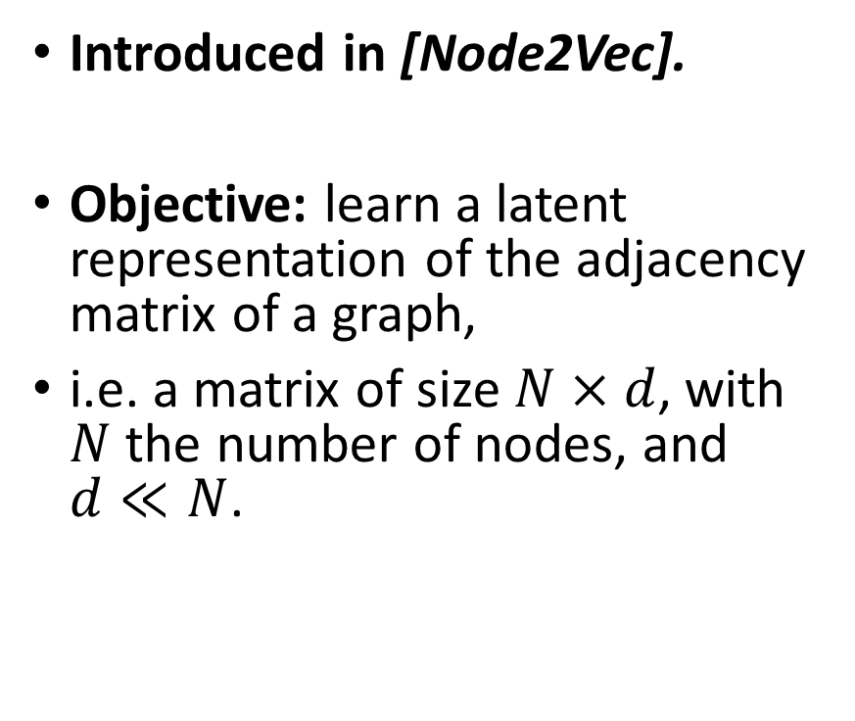
Local embeddings: Node2Vec
Introduced in [Node2Vec].
Objective: learn a latent representation of the adjacency matrix of a graph,
i.e. a matrix of size $N×d$, with $N$ the number of nodes, and $d≪N$.
Core Idea: As in DeepWalk, but next node is no longer decided using uniform random, to encourage exploration ($≈$ tSNE, which will be seen on week 12!).
Parameters:
$γ$, the number of random walks from each node,
$t$, the length of the walk,
$p$, the probability to return to previously visited node,
$q$, the probability to visit an unvisited node.
[Node2Vec] Grover, A., & Leskovec, J. (2016, August). node2vec: Scalable feature learning for networks.

Slide 46


Local embeddings: Node2Vec
Introduced in [Node2Vec].
Objective: learn a latent representation of the adjacency matrix of a graph,
i.e. a matrix of size $N×d$, with $N$ the number of nodes, and $d≪N$.
Core Idea: As in DeepWalk, but next node is no longer decided using uniform random, to encourage exploration ($≈$ tSNE, which will be seen later!).
Parameters:
$γ$, the number of random walks from each node,
$t$, the length of the walk,
$1/p$, the probability to return to previously visited node,
$1/q$, the probability to visit an unvisited node.
Encourage exploration: $1/p$ < $1/q$
[Node2Vec] Grover, A., & Leskovec, J. (2016, August). node2vec: Scalable feature learning for networks.

Slide 47


Local embeddings: Node2Vec
Introduced in [Node2Vec].
Encourage exploration: $1/p$ < $1/q$
Note: values of $p$ and $q$ will have to adjust dynamically, based on visited nodes and degree of current node.
Core Idea: As in DeepWalk, but next node is no longer decided using uniform random, to encourage exploration ($≈$ tSNE, which will be seen on week 12!).
Parameters:
$γ$, the number of random walks from each node,
$t$, the length of the walk,
$p$, the probability to return to previously visited node,
$q$, the probability to visit an unvisited node.
Paper with code: https://paperswithcode.com/paper/node2vec-scalable-feature-learning-for
[Node2Vec] Grover, A., & Leskovec, J. (2016, August). node2vec: Scalable feature learning for networks.

Slide 48


Advanced Embeddings: GraphSAGE
Introduced in [GraphSAGE].
Core idea: learn to propagate nodes information/features $h_{i}$ across the graph to compute new node features $h_{i}^{′}$.
Implemented as a SAGE inductive layer in our Neural Network.
[GraphSAGE] Hamilton, W., Ying, Z., & Leskovec, J. (2017). Inductive representation learning on large graphs.

Slide 49

Advanced Embeddings: GraphSAGE
Introduced in [GraphSAGE].
Core idea: learn to propagate nodes information/features $h_{i}$ across the graph to compute new node features $h_{i}^{′}$.
Implemented as a SAGE inductive layer in our Neural Network.
Propagation rule:
$$h_{i}^{k+1}=σ\left(W^{k}h_{i}^{k}, \sum_{j∈nbrs\left(i\right)}{σ\left(Q^{k}, h_{j}^{k}\right)}\right)$$
with $h_{i}^{0}=h_{i}$, the original node features,
and $\sum_{j∈nbrs(i)}{\left(…\right)}$, an aggregator function (mean, bi-directional RNN, max pooling, etc.)
[GraphSAGE] Hamilton, W., Ying, Z., & Leskovec, J. (2017). Inductive representation learning on large graphs.

Slide 50

Advanced Embeddings: GraphSAGE
Propagation rule:
$$h_{i}^{k+1}=σ\left(W^{k}h_{i}^{k}, \sum_{j∈nbrs\left(i\right)}{σ\left(Q^{k}, h_{j}^{k}\right)}\right)$$
with $h_{i}^{0}=h_{i}$, the original node features,
$\sum_{j∈nbrs(i)}{\left(…\right)}$, an aggregator function (mean sum, bi-directional RNN, etc.),
and $σ$, an activation, preferably ReLU.

Slide 51

Advanced Embeddings: GraphSAGE
Propagation rule:
$$h_{i}^{k+1}=σ\left(W^{k}h_{i}^{k}, \sum_{j∈nbrs\left(i\right)}{σ\left(Q^{k}, h_{j}^{k}\right)}\right)$$
with $h_{i}^{0}=h_{i}$, the original node features,
$\sum_{j∈nbrs(i)}{\left(…\right)}$, an aggregator function (mean sum, bi-directional RNN, etc.),
and $σ$, an activation, preferably ReLU.
Note: possible aggregators we have seen so far
Mean sum (as in CBoW)

Slide 52

Advanced Embeddings: GraphSAGE
Propagation rule:
$$h_{i}^{k+1}=σ\left(W^{k}h_{i}^{k}, \sum_{j∈nbrs\left(i\right)}{σ\left(Q^{k}, h_{j}^{k}\right)}\right)$$
with $h_{i}^{0}=h_{i}$, the original node features,
$\sum_{j∈nbrs(i)}{\left(…\right)}$, an aggregator function (mean sum, bi-directional RNN, etc.),
and $σ$, an activation, preferably ReLU.
Note: possible aggregators we have seen so far
Mean sum (as in CBoW)
Bi-directional RNN (as in ELMo)

Slide 53
Advanced Embeddings: GraphSAGE
Propagation rule:
$$h_{i}^{k+1}=σ\left(W^{k}h_{i}^{k}, \sum_{j∈nbrs\left(i\right)}{σ\left(Q^{k}, h_{j}^{k}\right)}\right)$$
with $h_{i}^{0}=h_{i}$, the original node features,
$\sum_{j∈nbrs(i)}{\left(…\right)}$, an aggregator function (mean sum, bi-directional RNN, etc.),
and $σ$, an activation, preferably ReLU.
Note: possible aggregators we have seen so far
Mean sum (as in CBoW)
Bi-directional RNN (as in ELMo)
Many other possibilities (e.g. pooling, etc.)

Slide 54

Advanced Embeddings: GraphSAGE
Propagation rule:
$$h_{i}^{k+1}=σ\left(W^{k}h_{i}^{k}, \sum_{j∈nbrs\left(i\right)}{σ\left(Q^{k}, h_{j}^{k}\right)}\right)$$
with $h_{i}^{0}=h_{i}$, the original node features,
$\sum_{j∈nbrs(i)}{\left(…\right)}$, an aggregator function (mean sum, bi-directional RNN, etc.),
and $σ$, an activation, preferably ReLU.
Procedure: supervised training to learn the weights in $W^{k}$ and $Q^{k}$.
Advantages:
Model has a constant number of parameters,
No need to know the adjacency matrix. Each node only need to know its list of immediate neighbours.
Fast and scalable inference,
Can be applied to any node in network,
Can be applied multiple times in a row to learn deeper features (reuse nodes features further away)

Slide 55
Advanced Embeddings: GraphSAGE
Introduced in [GraphSAGE] Hamilton, W., Ying, Z., & Leskovec, J. (2017). Inductive representation learning on large graphs.
Paper with code: https://paperswithcode.com/paper/inductive-representation-learning-on-large

Slide 56
Graph Attention Networks: core idea
Issue #4: Helping the graph identify more important nodes
Attention: selectively concentrating on a few relevant things, while ignoring others in deep neural networks.
Attention in NLP: identify words that are most relevant for a given word.
→ Attention in graphs to identify relevant neighboring nodes features for each node?

Slide 57

Graph Attention Networks: core idea
Introduced in [GraphSAT].
Core idea: By analogy with NLP, design a Graph Attention layer that
Receives the nodes features ${[h_{1}, …,h}_{i},…, h_{N}]$, for all the nodes ${\left(x_{i}\right)}_{i∈[1,N]}$ in a given graph, with $h_{i}∈ℝ^{F}.$
Outputs a new set of nodes features $\left[h_{1}^{′}, …,h_{i}^{′},…,h_{N}^{′}\right]\text{, }\text{with} h_{i}^{′}∈ℝ^{F^{′}}.$
[GraphSAT] Veličković, P., Cucurull, G., Casanova, A., Romero, A., Lio, P., & Bengio, Y. (2017). Graph attention networks.

Slide 58

Graph Attention Networks: implementation
Step 1: Linear transformation
Multiply the features $h_{i}$of each node $x_{i}$in the graph, with a weight matrix $W$ $(∈ ℝ^{F^{′}×F})$
With $F$, the number of the nodes features in $h_{i}$,
And $F^{’}$, the number of features expected at the end of the embedding.

Slide 59

Graph Attention Networks: implementation
Step 1: Linear transformation
Multiply the features $h_{i}$of each node $x_{i}$in the graph, with a weight matrix $W$ $(∈ ℝ^{F^{′}×F})$
With $F$, the number of the nodes features in $h_{i}$,
And $F^{’}$, the number of features expected at the end of the embedding.
Step 2: Compute attention coefficients
Using a shared attentional mechanism $a:$ $ℝ^{F^{′}}×ℝ^{F^{′}}→ ℝ$
$∀i,j∈\left[1,N\right]$, define the attention coefficient $e_{ij}$ as:
$$e_{ij}=a(Wh_{i}, Wh_{j})$$

Slide 60

Graph Attention Networks: implementation
Step 2(cont’d): Replace $a$ with a feedforward network,
with a weight vector $a∈ℝ^{2F^{′}}$,
and use LeakyReLU as activation.

Slide 61


Graph Attention Networks: implementation
Step 2(cont’d): Replace $a$ with a feedforward network,
with a weight vector $a∈ℝ^{2F^{′}}$,
and use LeakyReLU as activation.
Step 3: Normalize coefficients with softmax
$$α_{ij}=\frac{exp\left(e_{ij}\right)}{ \sum_{k∈nbrs(i)}{exp\left(e_{ik}\right){ }}}$$
$$α_{ij}=\frac{exp\left(e_{ij}\right)}{ \sum_{k∈nbrs(i)}{exp\left(e_{ik}\right){ }}} \\ =\frac{exp\left({LeakyReLU(a}^{T}\left[Wh_{i} | \left|Wh_{j}\right]\right)\right)}{\sum_{k∈nbrs(i)}{exp\left({LeakyReLU(a}^{T}\left[Wh_{i} | \left|Wh_{k}\right]\right)\right){ }}}$$

Slide 62

Graph Attention Networks: implementation
Step 4: Propagation rule
$$h_{i}^{′}=σ\left(\sum_{j∈nbrs\left(i\right)}{α_{ij}}Wh_{j}\right)$$

Slide 63

Graph Attention Networks: implementation
Step 4: Propagation rule
$$h_{i}^{′}=σ\left(\sum_{j∈nbrs\left(i\right)}{α_{ij}}Wh_{j}\right)$$
Step 5 (optional): use $K>1$ heads for attention mechanisms
$$h_{i}^{′}=\bigcup_{k=1}^{K}{σ\left(\sum_{j∈nbrs\left(i\right)}{α_{ij}^{k}}W^{k}h_{j}\right)}$$

Slide 64

Graph Attention Networks: implementation
Step 4: Propagation rule
$$h_{i}^{′}=σ\left(\sum_{j∈nbrs\left(i\right)}{α_{ij}}Wh_{j}\right)$$
Step 5 (optional): use $K>1$ heads for attention mechanisms
$$h_{i}^{′}=\bigcup_{k=1}^{K}{σ\left(\sum_{j∈nbrs\left(i\right)}{α_{ij}^{k}}W^{k}h_{j}\right)}$$
With $\bigcup_{k=1}^{K}{…}$, an aggregation mechanism (such as concatenation, or as shown below, averaging)
$$h_{i}^{′}=\frac{1}{K}σ\left(\sum_{k=1}^{K}{\sum_{j∈nbrs\left(i\right)}{α_{ij}^{k}}W^{k}h_{j}}\right)$$

Slide 65
Graph Attention Networks: recap
Introduced in [GraphSAT] Veličković, P., Cucurull, G., Casanova, A., Romero, A., Lio, P., & Bengio, Y. (2017). Graph attention networks.
Paper with code: https://paperswithcode.com/paper/graph-attention-networks

Slide 66
Conclusion
In this lecture
Building a Graph Convolutional Neural Network for classification
Training a Graph Convolutional Neural Network
Feature Engineering for Graph Convolutional Neural Networks
In this lecture, also
Limits of basic approaches
Graph Convolutional Neural Networks with Attention Mechanisms
Some more advanced embeddings
Open questions in Graph Convolutional Neural Networks

Slide 67
Learn more about these topics
Out of class, for those of you who are curious
[Kipf] Kipf et al., “Semi-supervised classification with graph convolutional networks”, 2016.
[ZKC] Zachary, “An information flow model for conflict and fission in small groups”, 1977.
[Xu] Xu et al., “How powerful are graph neural networks?”, 2018.
[DeepWalk] Perozzi et al., “Deepwalk: Online learning of social representations”, 2014.

Slide 68
Learn more about these topics
Out of class, for those of you who are curious
[Node2Vec] Grover et al. , “Node2vec: Scalable feature learning for networks”, 2016.
[GraphSAGE] Hamilton et al., “Inductive representation learning on large graphs”, 2017.
[GraphSAT] Veličković, Cucurull, Casanova, Romero, Lio, & Bengio, “Graph attention networks”, 2017.

Slide 69
Learn more about these topics
Tracking important names (Track their works and follow them on Scholar, Twitter, or whatever works for you!)
Thomas Kipf: Research Scientist at Google Brain. https://scholar.google.de/citations?user=83HL5FwAAAAJ&hl=en https://tkipf.github.io
Max Welling: Professor at University of Amsterdam. https://scholar.google.com/citations?user=8200InoAAAAJ&hl=fr&oi=sra
Rianne Van Den Berg: Researcher at Microsoft. https://scholar.google.com/citations?user=KARgiboAAAAJ&hl=fr&oi=sra

Slide 70
Learn more about these topics
Tracking important names (Track their works and follow them on Scholar, Twitter, or whatever works for you!)
Adriana Romero-Soriano: Researcher at Facebook AI. https://scholar.google.com/citations?user=Sm15FXIAAAAJ&hl=fr&oi=sra
Petar Veličković: Researcher at DeepMind and Affiliated Lecturer at Cambridge University. https://scholar.google.com/citations?user=kcTK_FAAAAAJ&hl=fr&oi=sra
Jure Leskovec: Professor at Stanford University. https://scholar.google.com/citations?user=Q_kKkIUAAAAJ&hl=fr&oi=sra

